Slide 1
Ch3--
ILP & its exploration
Ch3-1
Instruction Level Parallelism
Basic Compiler Techniques
for Exposing ILP
Dynamic scheduling--Scoreboard
3.1, 3.2, App C7

Slide 2
What is Instruction-Level Parallelism ?
Instruction-level parallelism
  The potential overlap among instructions
Basic Block ILP is quite small
  Basic Block: a straight-line code sequence with no branches in except to the entry and no branches out except at the exit
  average dynamic branch frequency 15% to 25%
  => 4 to 7 instructions execute between a pair of branches
  Plus instructions in BB likely to depend on each other

Slide 3
Recall from Pipelining Review
When exploiting instruction-level parallelism, goal is to maximize CPI
Pipeline CPI = Ideal pipeline CPI + Structural Stalls + Data Hazard Stalls + Control Stalls
  Ideal pipeline CPI: measure of the maximum performance attainable by the implementation
  Structural hazards: HW cannot support this combination of instructions
  Data hazards: Instruction depends on result of prior instruction still in the pipeline
  Control hazards: Caused by delay between the fetching of instructions and decisions about changes in control flow (branches and jumps)

Slide 4
How to exploit ILP？
there are two main approaches:
  Hardware-based dynamic approaches
    Used in server and desktop processors
    Not used as extensively in PMP processors
  Compiler-based static approaches
    Not as successful outside of scientific applications

Slide 5
Chapter 3
ILP: Concepts and Challenge
Basic compiler Techniques for exposing ILP
Overcoming Data Hazards with Dynamic Scheduling
Reducing Branch Costs with Dynamic Branch Prediction
Hardware-based Speculation
Exploiting ILP with Multiple Issue & Static Scheduling
Exploiting ILP with Dynamic scheduling, Multiple issue, & speculation
Advanced Techniques for instruction Delivery and speculation
Multithreading: exploiting TLP improve uniprocessor throughput

Slide 6
Ideas to Reduce Stalls
ChC
Ch3
ChH

Slide 7
Instruction-Level Parallelism (ILP)
To obtain substantial performance enhancements, we must exploit ILP across multiple basic blocks
Simplest: loop-level parallelism to exploit parallelism among iterations of a loop
  Vector & GPU is one way
  If not vector, then either dynamic via branch prediction or static via loop unrolling by compiler

Slide 8
Data Dependence & hazard
Dependencies are a property of programs, presence of dependence indicates potential for a hazard,
Pipeline organization determines if dependence is detected and if it causes a stall, actual hazard and length of any stall is a property of the pipeline
Data dependence conveys:
  Possibility of a hazard ( register & memory location)
  Order in which results must be calculated
  Upper bound on exploitable instruction level parallelism
Dependencies that flow through memory locations are difficult to detect

Slide 9
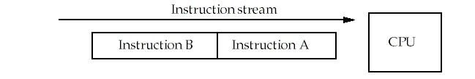
Recall: Types of data hazards
Consider two instructions, A and B. A occurs before B.
RAW( Read after write) true dependence
  Instruction A writes Rx，instruction B reads Rx
WAW(Write after write) output dependence
  Instruction A writes Rx，instruction B writes Rx
WAR( Write after read) anti-denpendence
  Instruction A reads Rx，instruction B writes Rx
Hazards are named according to the ordering that MUST be preserved by the pipeline

Slide 10
True Data Dependence and Hazards
True Data Dependence:
  Instr_{J} is data dependent on Instr_{I}
  Instr_{J} tries to read operand before Instr_{I} writes it
  or Instr_{J} is data dependent on Instr_{K} which is dependent on Instr_{I}
Caused by a “True Dependence” (compiler term)
If true dependence caused a hazard in the pipeline, called a Read After Write (RAW) hazard
I: add r1,r2,r3
J: sub r4,r1,r3

Slide 11
Name Dependence 1:Anti-dependence
Name dependence: when 2 instructions use same register or memory location, called a name, but no flow of data between the instructions associated with that name;
Instr_{J} writes operand before Instr_{I} reads it
called an “anti-dependence” by compiler writers.
This results from reuse of the name “r1”
If anti-dependence caused a hazard in the pipeline, called a Write After Read (WAR) hazard
I: sub r4,r1,r3
J: add r1,r2,r3
K: mul r6,r1,r7

Slide 12
Name Dependence 2: Output dependence
Instr_{J} writes operand before Instr_{I} writes it.
Called an “output dependence” by compiler writers
This also results from the reuse of name “r1”
If anti-dependence caused a hazard in the pipeline, called a Write After Write (WAW) hazard
I: sub r1,r4,r3
J: add r1,r2,r3
K: mul r6,r1,r7

Slide 13
Name Dependence
Two instructions use the same name but no flow of information
  Not a true data dependence, but is a problem when reordering instructions
  Antidependence: instruction j writes a register or memory location that instruction i reads
    Initial ordering (i before j) must be preserved
  Output dependence: instruction i and instruction j write the same register or memory location
    Ordering must be preserved

Slide 14
ILP and Data Hazards
HW/SW must preserve program order:
order instructions would execute in if executed sequentially 1 at a time as determined by original source program
HW/SW goal: exploit parallelism by preserving program order only where it affects the outcome of the program
Instructions involved in a name dependence can execute simultaneously if name used in instructions is changed so instructions do not conflict
  Register renaming resolves name dependence for registers
  Either by compiler or by HW

Slide 15
Control Dependencies
Every instruction is control dependent on some set of branches, and, in general, these control dependencies must be preserved to preserve program order
  if p1 {
  S1;
  };
  if p2 {
  S2;
  }
S1 is control dependent on p1, and S2 is control dependent on p2 but not on p1.

Slide 16
Control Dependence Ignored
Control dependence need not be preserved
  willing to execute instructions that should not have been executed, thereby violating the control dependences, if can do so without affecting correctness of the program
Instead, 2 properties critical to program correctness are exception behavior and data flow

Slide 17
Examples
Example 1:
add x1,x2,x3
beq x4,x0,L
sub x1,x1,x6
L: …
or x7,x1,x8
Example 2:
add x1,x2,x3
beq x12,x0,skip
sub x4,x5,x6
add x5,x4,x9
skip:
or x7,x8,x9
or instruction dependent on add and sub
Assume x4 isn’t used after skip
  Possible to move sub before the branch

Slide 18
Exception Behavior
Preserving exception behavior
=> any changes in instruction execution order must not change how exceptions are raised in program
(=> no new exceptions)
  Example:
  DADDU R2,R3,R4
  BEQZ R2,L1
  LW R1,0(R2)
  L1: ……
Problem with moving LW before BEQZ?

Slide 19
A short summary
ILP
  The potential overlap among instructions
Reduce stalls from
  Structural hazards
  Data hazards
  Control hazards
To keep the program correctness, we should
  Preserving Data flow
  Preserving exception behavior

Slide 20
Lecture for ILP: Software approaches
Basic Compiler Technique for Exposing ILP
  Loop unrolling
Static Branch Prediction
Static multiple Issue: VLIW
Advanced Compilor Support for Exposing and Exploiting ILP
  Software pipelining
  Global Code scheduling
Hardware Support for Exposing More Parallelism at compile time
  Conditional or Predicated instructions
  Compiler speculation with hardware support

Slide 21
FP Loop: Where are the Hazards?
Loop: LD F0,0(R1) ;F0=vector element
ADDD F4,F0,F2 ;add scalar from F2
SD 0(R1),F4 ;store result
SUBI R1,R1,8 ;decrement pointer 8B (DW)
BNEZ R1,Loop ;branch R1!=zero
NOP ;delayed branch slot
Instruction Instruction Execution Latency
producing result using result in cycles in cycles
FP ALU op Another FP ALU op 4 3
FP ALU op Store double 3 2
Load double FP ALU op 1 1
Load double Store double 1 0
Integer op Integer op 1 0
Where are the stalls?

Slide 22
Specification for the latency
ALU F1, -,- : IF ID FD FD FD FD WB
ALU -, F1,-: IF ID s s s FD FD FD FD WB
ALU: IF ID FD FD FD FD WB
SW: IF ID s s EX DM
LW F1, - : IF ID EX DM WB
SW: F1, 8(R1): IF ID EX DM WB
MEM/WB.LDMR --→DM input port

Slide 23
Reducing stalls from scheduling in BB and delayed branch
Loop: LD F0, 0(R1)
ADDD F4, F0, F2
SD 0(R1), F4
SUBI R1, R1, #8
BNEZ R1, Loop
F D X M W
F D s A₁ A₂ A₃ A₄ W
F s D s s X M W
F s s D X M W
F s D X M W
10 CC F F
Loop: LD F0, 0(R1)
SUBI R1, R1,#8
ADDD F4, F0, F2
BNEZ R1, Loop
SD +8(R1), F4
F D X M W
F D X M W
F DA₁A₂A₃A₄W
F D X M W
F D s X M W
6 CC F s D X M W

Slide 24
Unroll Loop Four Times (straightforward way)
1 cycle stall
1 Loop: LD F0,0(R1)
2 ADDD F4,F0,F2
3 SD 0(R1),F4 ;drop SUBI & BNEZ
4 LD F6,-8(R1)
5 ADDD F8,F6,F2
6 SD -8(R1),F8 ;drop SUBI & BNEZ
7 LD F10,-16(R1)
8 ADDD F12,F10,F2
9 SD -16(R1),F12
10 LD F14,-24(R1)
11 ADDD F16,F14,F2
12 SUBI R1,R1,#32 ;alter to 4*8
13 SD +8(R1),F16
14 BNEZ R1,LOOP
NOP
14 + 3 x (1+2) +1 +1 +1= 26 clock cycles, or 6.5 per iteration
Assumes R1 is multiple of 4
Rewrite loop to minimize stalls?
2 cycles stall
1 cycle stall
1 cycle stall(waiting for F16
1 cycle control stall

Slide 25
Unrolled Loop That Minimizes Stalls
1 Loop: LD F0,0(R1)
2 LD F6,-8(R1)
3 LD F10,-16(R1)
4 LD F14,-24(R1)
5 ADDD F4,F0,F2
6 ADDD F8,F6,F2
7 ADDD F12,F10,F2
8 ADDD F16,F14,F2
9 SD 0(R1),F4
10 SD -8(R1),F8
11 SUBI R1,R1,#32
12 SD +16(R1),F12
13 BNEZ R1,LOOP
14 SD 8(R1),F16 ; 8-32 = -24
14 clock cycles, or 3.5 per iteration
What assumptions made when moved code?
  OK to move store past SUBI even though changes register
  OK to move loads before stores: get right data?
  When is it safe for compiler to do such changes?

Slide 26
Ideas to Reduce Stalls
ChC
Ch3
ChH

Slide 27
Why Dynamic Scheduling ?
Example1 :
  DIVD F0,F2,F4
  ADDD F10,F0,F8
  SUBD F12,F8,F14
Example2: Structure Hazard
    DIVD F2,F2,F4
    ADDD F10,F0,F8 ; FP ADDer unpipelined
    ADDD F12, F0,F4
    MULD F16, F14, F4
Problem: instruction (SUBD, MULD) stalled
due to irrelevent forward instructions.

Slide 28
HW Schemes: Dynamic scheduling
Key idea: Allow instructions behind stall to proceed. Rearrange order of instructions to reduce stalls while maintaining data flow
Enables out-of-order execution
and allows out-of-order completion
Will distinguish when an instruction begins execution and when it completes execution; between 2 times, the instruction is in execution
In a dynamically scheduled pipeline, all instructions pass through issue stage in order (in-order issue)

Slide 29
Adv. Of Dynamic Scheduling
Handles cases when dependences unknown at compile time
  (e.g., because they may involve a memory reference)
It simplifies the compiler, Compiler doesn’t need to have knowledge of microarchitecture
Allows code that compiled for one pipeline to run efficiently on a different pipeline
Hardware speculation, a technique with significant performance advantages, that builds on dynamic scheduling

Slide 30
Dynamic Scheduling Step 1
Simple pipeline had 1 stage to check both structural and data hazards: Instruction Decode (ID), also called Instruction Issue
Split the ID pipe stage of simple 5-stage pipeline into 2 stages:
Issue—Decode instructions, check for structural hazards
Read operands—Wait until no data hazards, then read operands

Slide 31
Dynamic Scheduling with a Scoreboard
Scoreboarding
  Named after CDC6600 scoreboard
  Allowing instructions to execute out of order when there are sufficient resources and no data dependences.
  In-order issue
  Out-of order completion
  Executing an instruction as early as possible

Slide 32
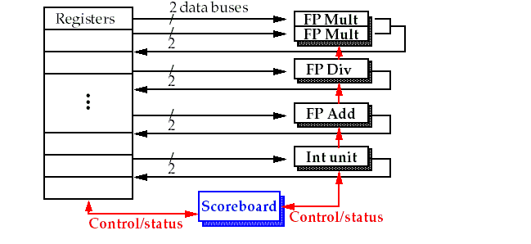
Basic structure of a pipelined processor with a scoreboard

Slide 33
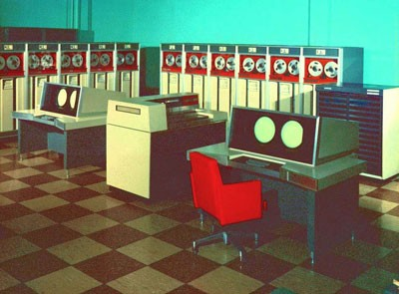
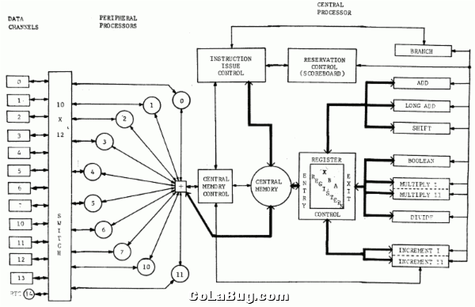
CDC6600 –First Supercomputer top1 1964-1969

Slide 34
The pipeline stages with scoreboard
The Five stages: IF, ID, EX, MEM, WB
  IF: the same for all instructions
  ID: split into two stages: issue and read operands
  EX: no change
  MEM: omitted for only concentrating on the FP operations
  WB: no change
So, the stages are: IF, IS, RO, EX,WB.
Another way to lookat missing MEM ?

Slide 35
Pipeline supports multiple outstanding FP operations
EX
MEM
M1
M2
M3
M4
M5
M6
M7
WB
IF
ID
A1
A2
A3
A4
DIV

Slide 36
Scoreboard Pipeline stage description
Issue: a instruction is issued when
  The functional unit is available and
  No other active instruction has the same destination register.
  Avoid strutural hazard and WAW hazard
Read Operands (RO)
  The read operation is delayed until both the operands are available.
  This means that no previously issued but ncompleted instruction has the operand as its destination.
  This resolves RAW hazards dynamically
Execution (EX)
  Notify the scoreboard when completed so the functional unit can be reused.
Write result (WB)
  The scoreboard checks for WAR hazards and stalls the completing instruction if necessary.

Slide 37
The scoreboard algorithm
Scoreboard-takes full responsibility for instruction issue and execution
  Create the dependence records
  Decide when to fetch the operand
  Decide when to enter execution
  Decide when the result can be written into the register file
Three data structure
  Instruction status:
    which of the four steps the instruction is in
  Functional unit status: buzy,op,Fi, Fj,Fk,Qj,Qk ,Rj,Rk
  Register result status:
    which functional unit will write that register

Slide 38
Example: Instruction status
LD F6, 34(R2)
LD F2, 45(R3)
MULTD F0, F2, F4
SUBD F8, F6, F2
DIVD F10, F0, F6
ADDD F6, F8, F2

Slide 39
Scoreboard Example
Clock cycle
counter

Slide 40
Scoreboard Cycle 1
Clock cycle
counter

Slide 41
Scoreboard Cycle 2
Clock cycle
counter

Slide 42
Scoreboard Cycle 3
Clock cycle
counter

Slide 43
Scoreboard Cycle 4
Clock cycle
counter

Slide 44
Scoreboard Cycle 5
Clock cycle
counter

Slide 45
Scoreboard Cycle 6
Clock cycle
counter

Slide 46
Scoreboard Cycle 7

Slide 47
Scoreboard Cycle 8
Clock cycle
counter

Slide 48
Scoreboard Cycle 9
Clock cycle
counter

Slide 49
Example: Function unit status and Register status

Slide 50
Scoreboard Cycle 10
Clock cycle
counter

Slide 51
Scoreboard Cycle 11
Clock cycle
counter

Slide 52
Scoreboard Cycle 12

Slide 53
Scoreboard Cycle 15

Slide 54
Scoreboard Cycle 16

Slide 55
Scoreboard Cycle 17

Slide 56
Scoreboard Cycle 18

Slide 57
Scoreboard Cycle 19

Slide 58
Examples: Dynamic Scheduling
Dynamic scheduling implies:
  Out-of-order execution
  Out-of-order completion
Example 1:
  fdiv.d f0,f2,f4
  fadd.d f10,f0,f8
  fsub.d f12,f8,f14
  fsub.d is not dependent, issue before fadd.d
Example 2:
  fdiv.d f0,f2,f4
  fmul.d f6,f0,f8
  fadd.d f0,f10,f14
  fadd.d is not dependent, but the antidependence makes it impossible to issue earlier without register renaming

Slide 59
Register Renaming
Example 3:
fdiv.d f0,f2,f4
fadd.d f6,f0,f8
fsd f6,0(x1)
fsub.d f8,f10,f14
fmul.d f6,f10,f8
antidependence
antidependence

Slide 60
Register Renaming
Example 3:
fdiv.d f0,f2,f4
fadd.d S,f0,f8
fsd S,0(x1)
fsub.d T,f10,f14
fmul.d f6,f10,T
Now only RAW hazards remain, which can be strictly ordered

Slide 61
Limitations of Scoreboard-1
ILP
  If we can't find independent instructions to execute, scoreboard (or any dynamic scheduling scheme for that matter) helps very little.
Size of the "issued" queue
  This determines how far ahead the CPU can look for instructions to execute in parallel.
  It's called the window.
  For now, we assume that a window can not span a branch.
  In other words, the window includes instructions only within basic blocks.

Slide 62
Limitations of Scoreboard-2
Number, types, and speed of the functional units
  This determines how often a structural hazard results in stall.
The presence of anti-dependences and output dependences
  WAR and WAW hazards limit the scoreboard more than RAW hazards, lead to WAR and WAW stalls.
  RAW hazards are problems for any technique.
  But WAR and WAW hazards can be solved in ways other than scoreboards.

Slide 63
Scoreboard vs. Tomasulo
特点
  Multiple multiplier, etc. Funcs
  Issue in order, Complete OOO
  IF→ Issue, Ro
  4 stages pipeline
  Scoreboare centralized control
缺点
  Stall when WAW, WAR
  Fewer Func, unpipelined
  Issue in order, Complete OOO
  FP op. queue, Reservation station, LD/ST buffer, CDB
  Reg. Rename→No WAW, WAR
  Reduce structural hazard
  RAW detection decentralized—reservation
  CDB→ forwarding path

